Slide 1


The Run 3 milliQan Detector: status and first data
Outline:
- Motivation
- Detector design
- Search method
- Commissioning w/ Run 3 data
David Stuart, University of California Santa Barbara
on behalf of the MilliQan Collaboration
August 22, 2023 – EPS23

Slide 2
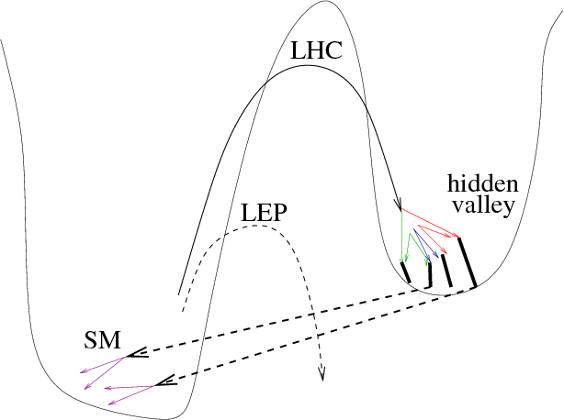
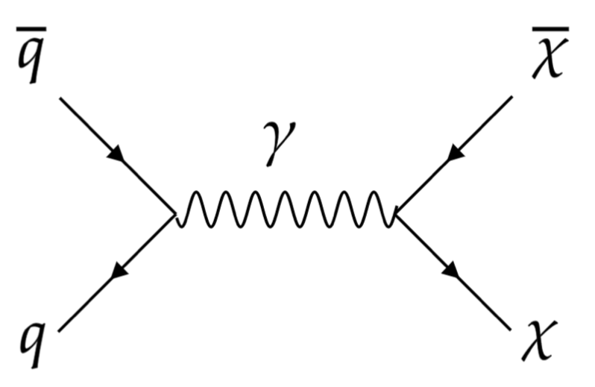
Motivation for milli-charged particle search
Hidden sector models could contain low-mass particles but still evade existing searches if the hidden sector is separated by a heavy mediator or small couplings.
Targeted searches could reveal them.
A
A’
Hidden sector
(including stable
DM particles)
Standard model
communicator
SM Sector
Dark Sector
Dark EM charge,
e’ = 𝜖e
Production and interactions each suppressed by 𝜖²
Zurek, Strassler
2/26

Slide 3
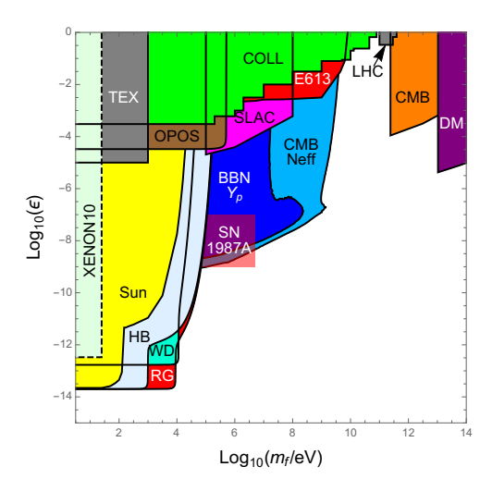
Previous milli-charged particle searches
Limits set on mCPs in effective charge (ϵ) & mass
  Cosmological limits
  Collider experiments (CMS, SLAC, etc)
Large gap for masses O(1-10) GeV
milliQan probes this range, searching for mCP production at the LHC
(Effective charge)
CMS fractional charge search
Region targeted by milliQan
Cosmological Limits
carrigan.20@osu.edu
3/26

Slide 4
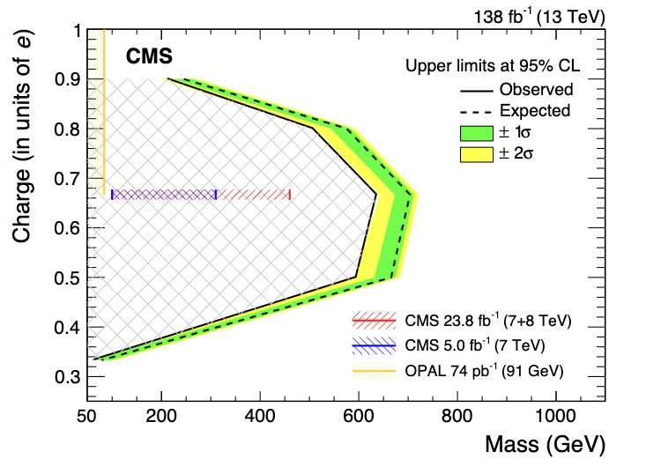
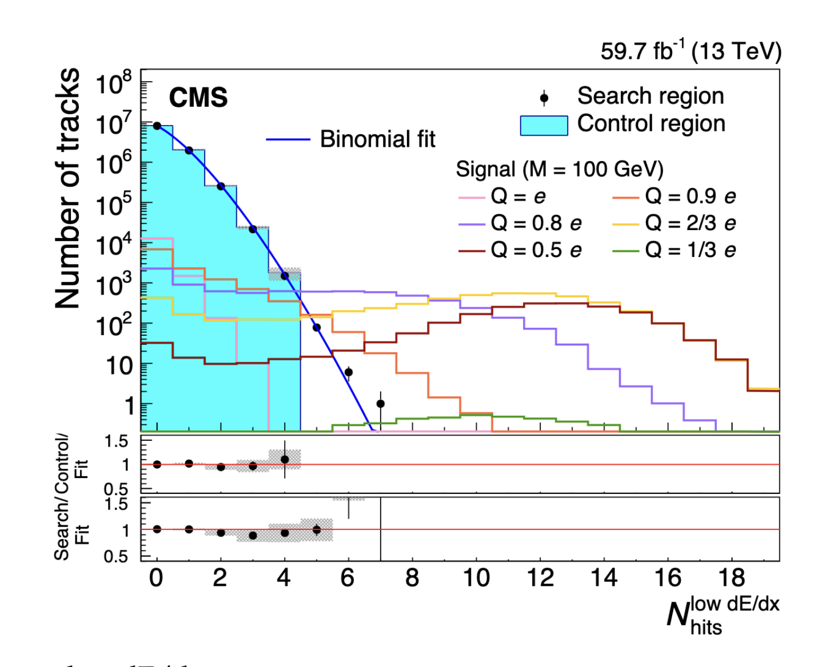
Previous milli-charged particle searches at the LHC
CMS Fractionally charged particle search
EXO-19-006
Sensitivity down to about e/3
Limited by threshold in silicon-strip tracker
carrigan.20@osu.edu
4/26

Slide 5
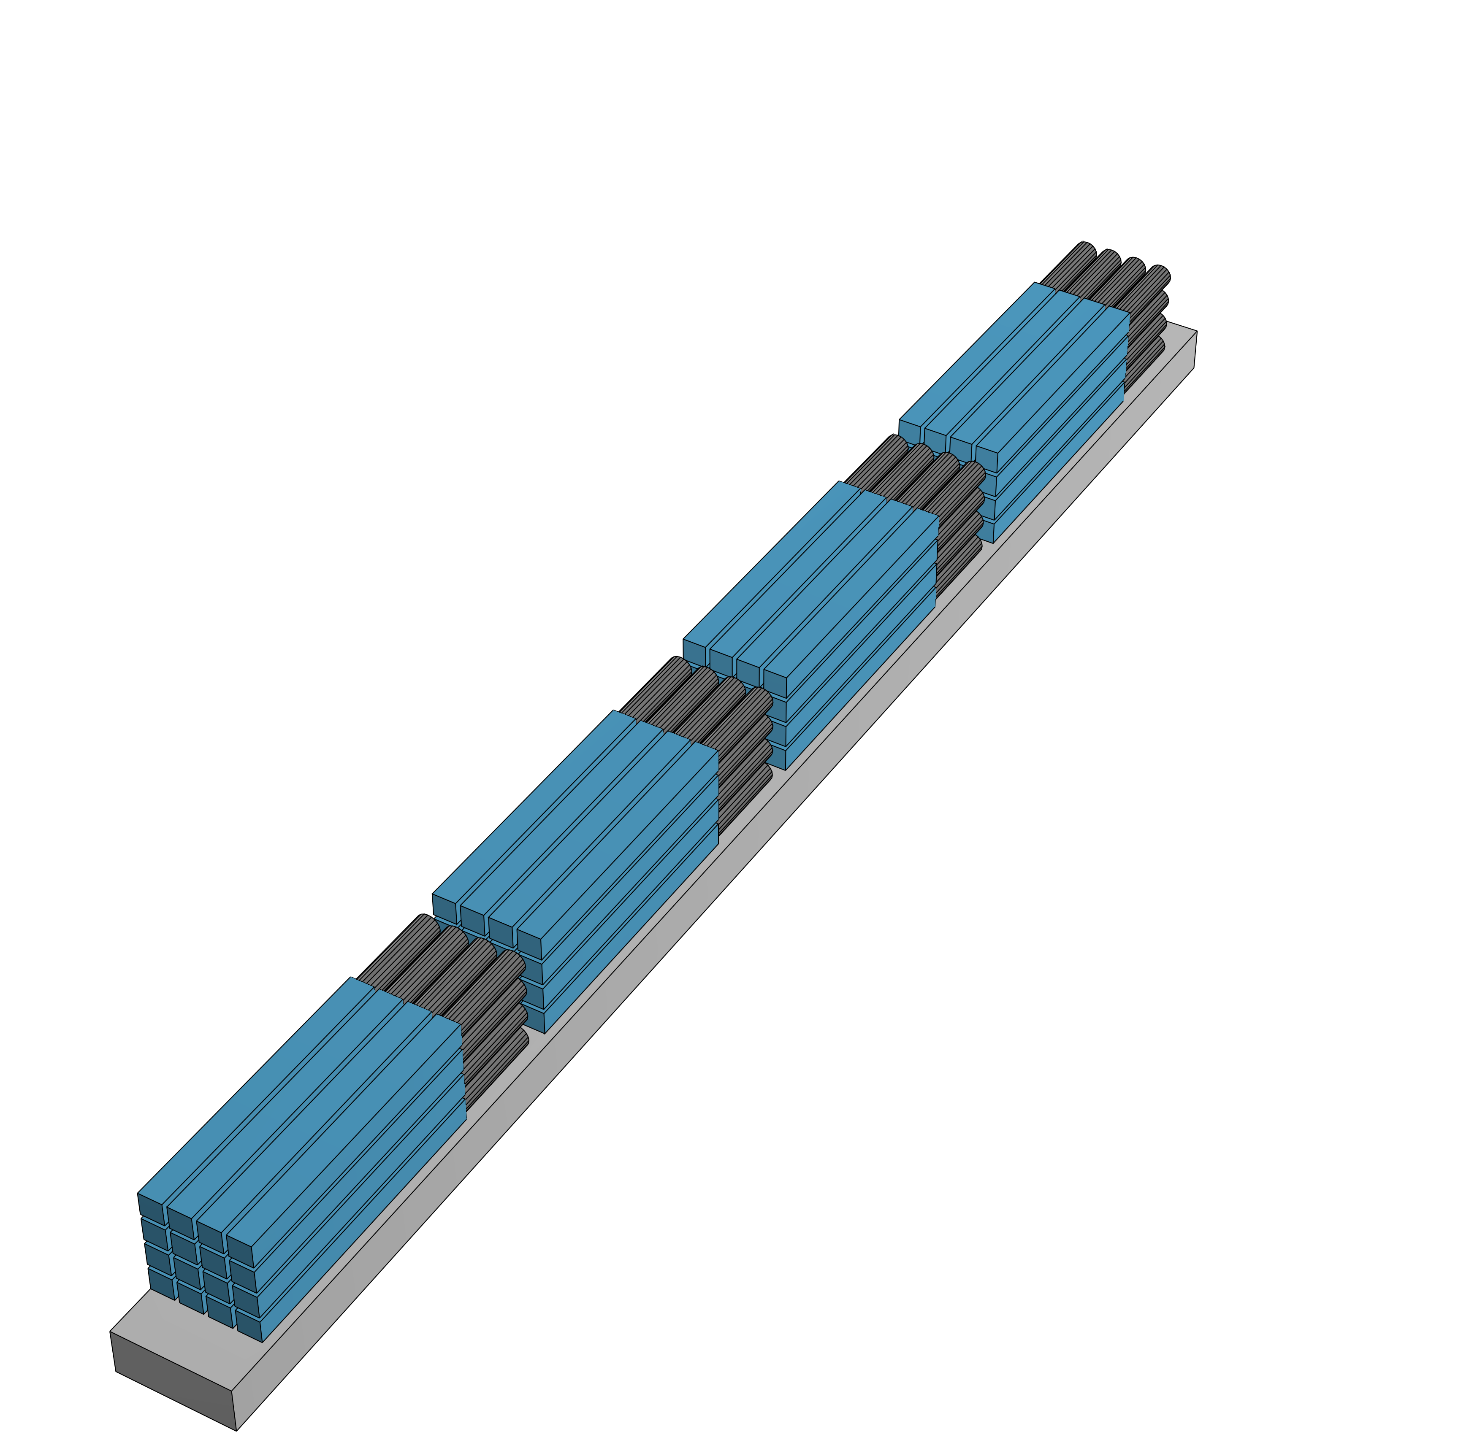
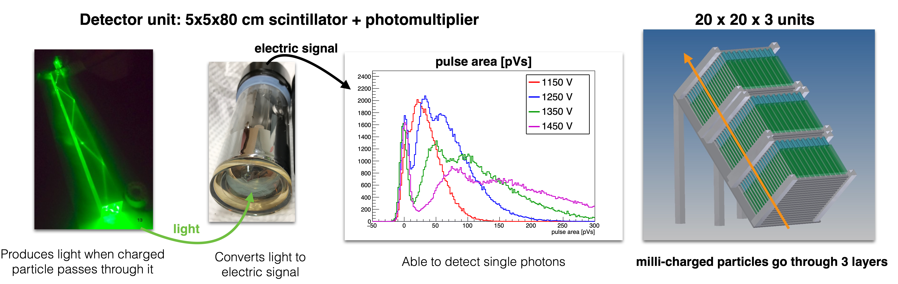
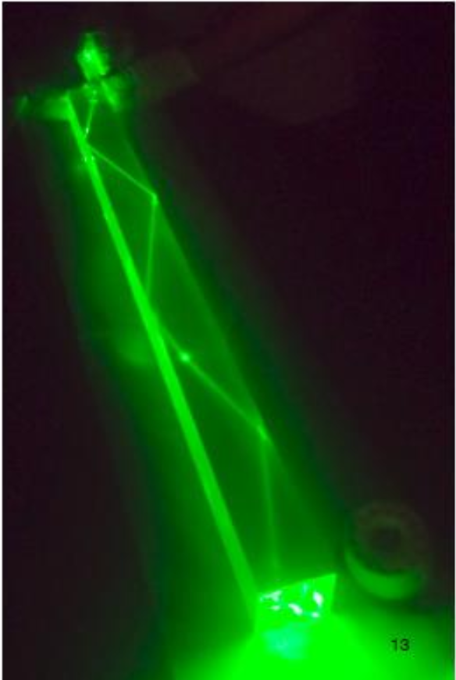
The MilliQan search for milli-charged particles at the LHC
Key idea: use array of long scintillator bars to detect very small ionization from low-charged particles
Expected signal: few scintillation photons in multiple layers
Each bar + PMT must be capable of detecting a single scintillation photon
Control backgrounds: signal in each layer within small (~15 ns) time window, in a line that points towards the IP
Scintillator
PMT
60 cm
Scintillator bar
5 cm
Run 3 milliQan
detector
LHC
IP
5/26

Slide 6
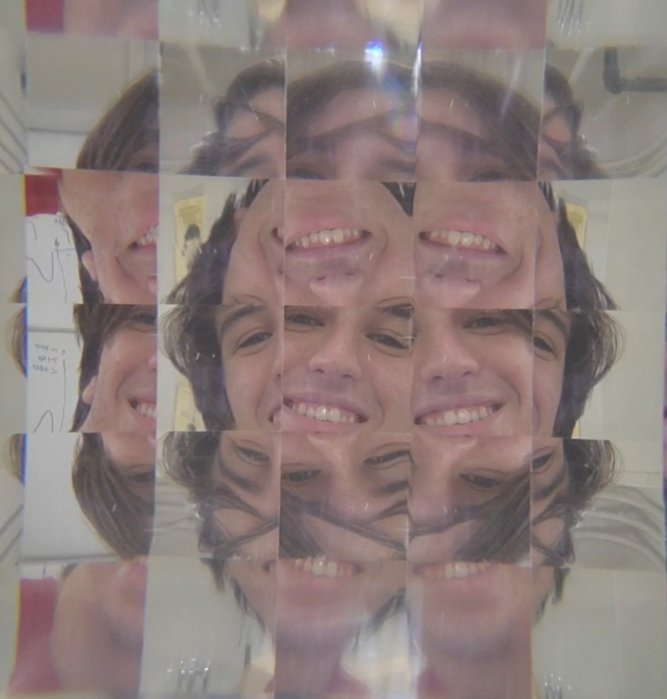
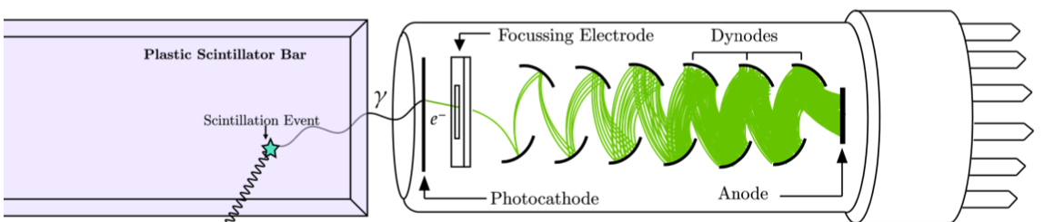
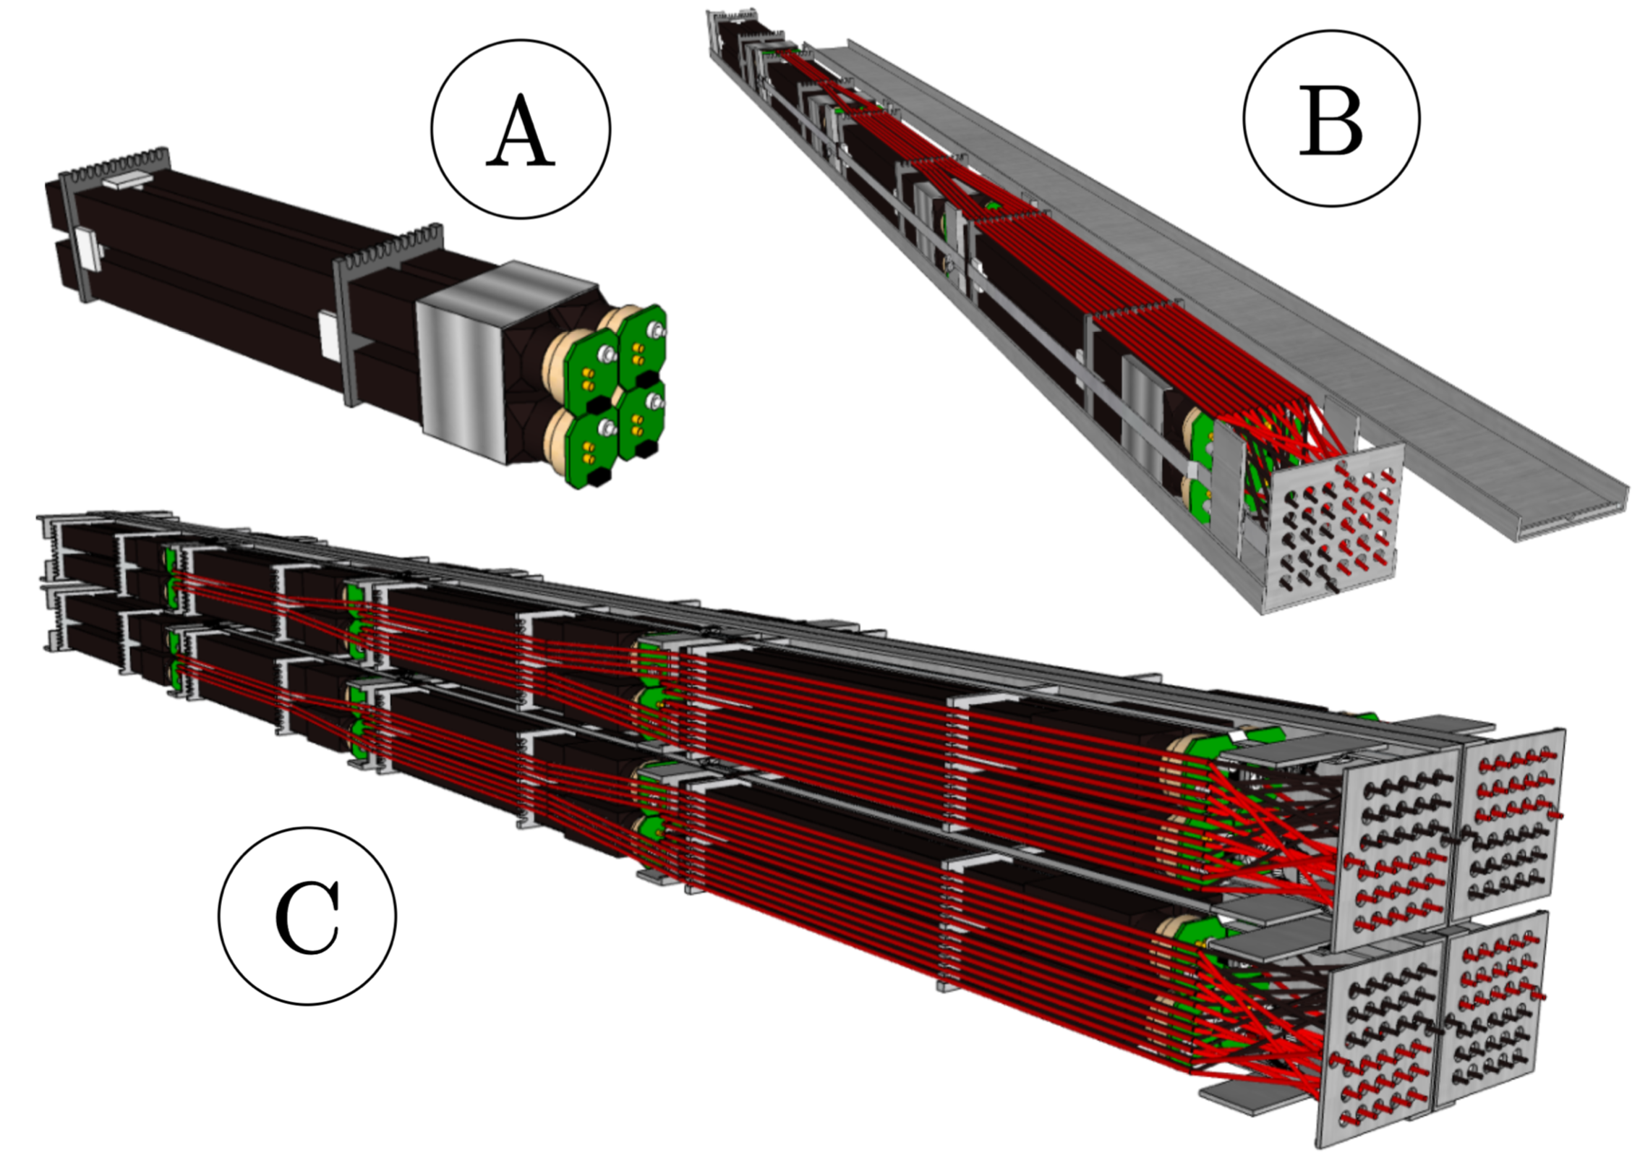
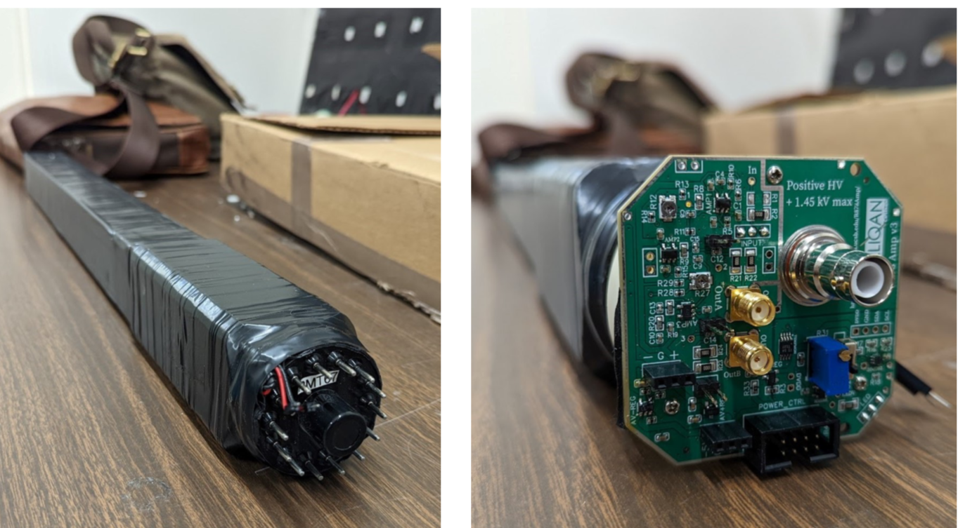
MilliQan detector design
CMS experimental site (P5)
milliQan
6/26

Slide 7
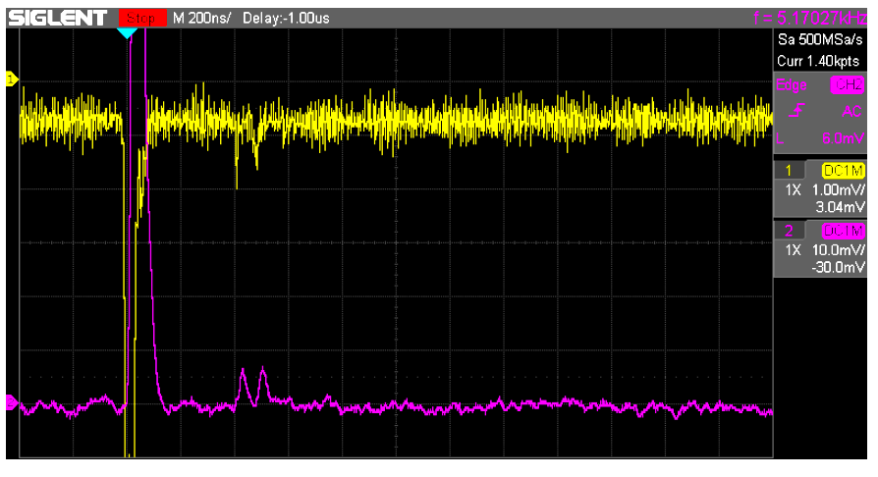
MilliQan detector design – amplifiers
CMS experimental site (P5)
Electronic amplification built into PMT bases to allow reuse of existing PMTS for cost savings
milliQan
7/26

Slide 8
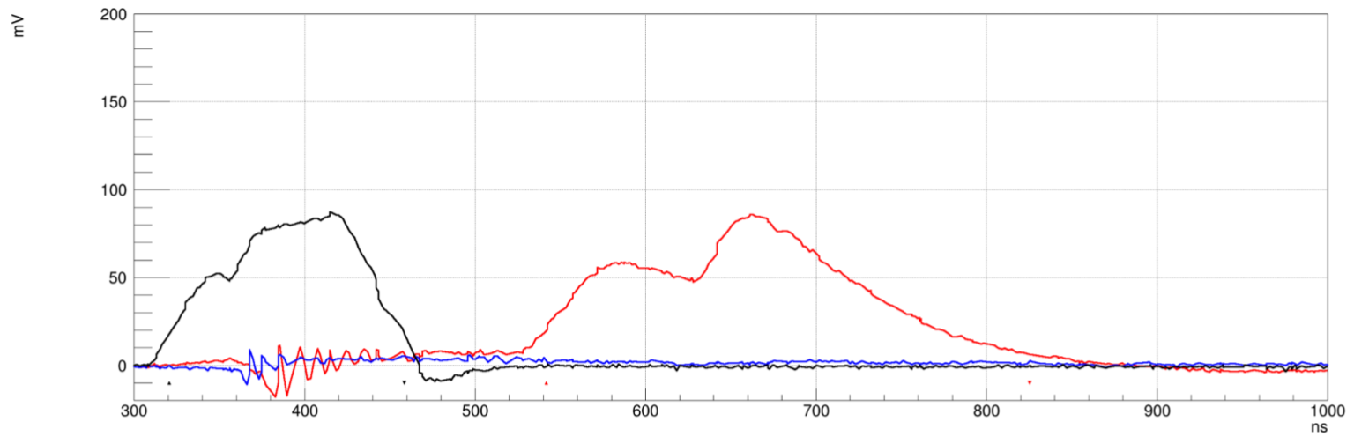
MilliQan detector design – LED pulsing
CMS experimental site (P5)
Electronic amplification built into PMT bases to allow reuse of existing PMTS for cost savings
milliQan
LED pulse
PMT+amp output
Sample voltage [mV]
8/26

Slide 9
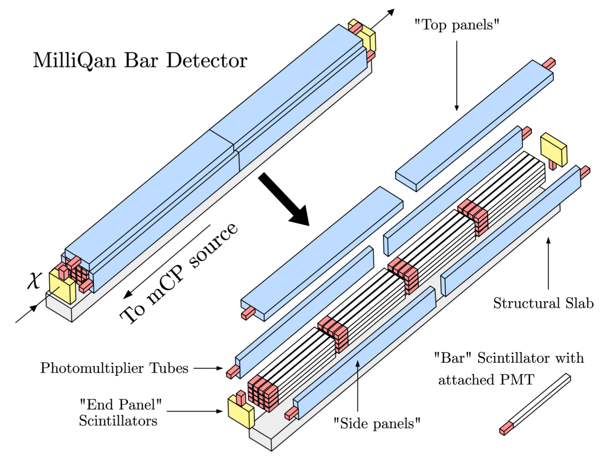
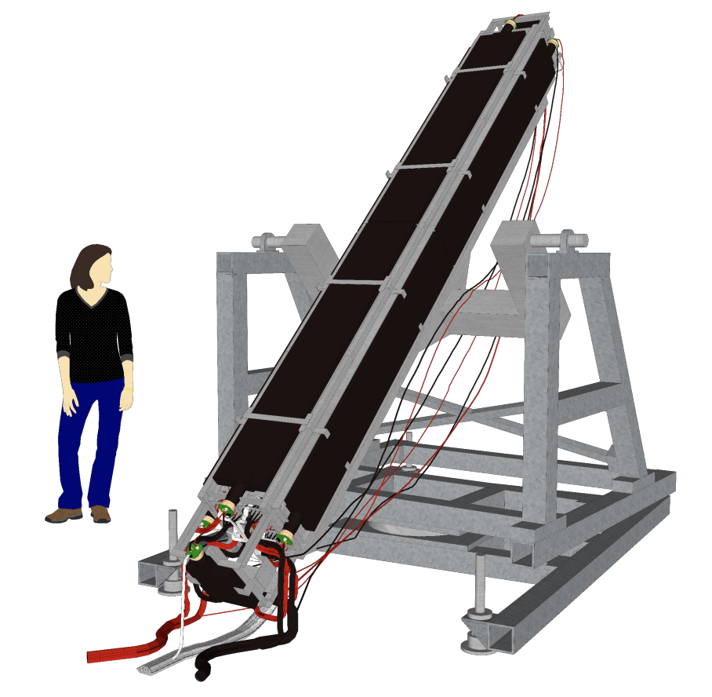
MilliQan detector design – mechanics
Cover with scintillator panels to tag muons and veto backgrounds
Mount on support plate, tilted to orient to IP
Hodoscope for aligment with muons using
~15x15x240 mm bars
with SiPM readout
milliQan
Support
plate
9/26

Slide 10
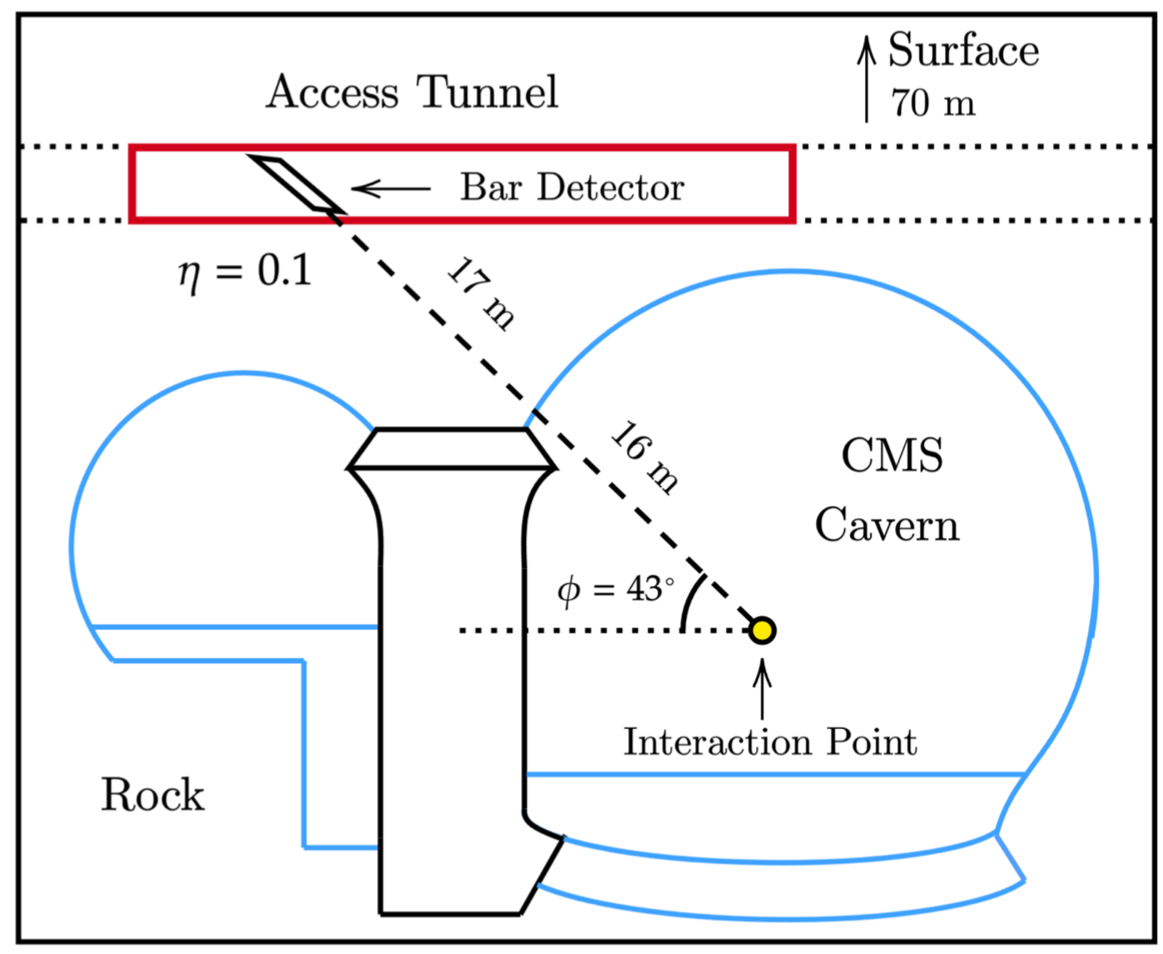
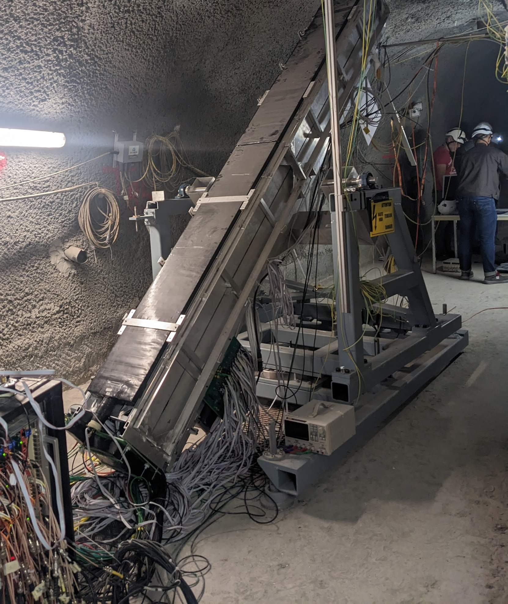
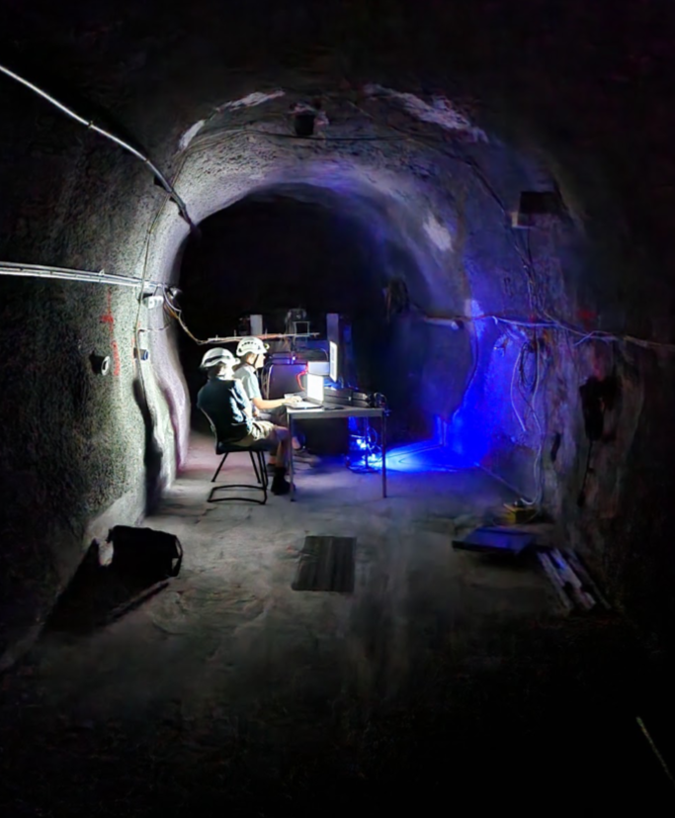
MilliQan experiment location
Place detector near CMS collision point, within existing ‘drainage gallery’
Location 33 m from interaction point (including 17 m of rock) → suppresses Q=1 beam particles
η ≈ 0.1, pointed down toward IP at ϕ = 43º
CMS experimental site (P5)
milliQan
10/26

Slide 11
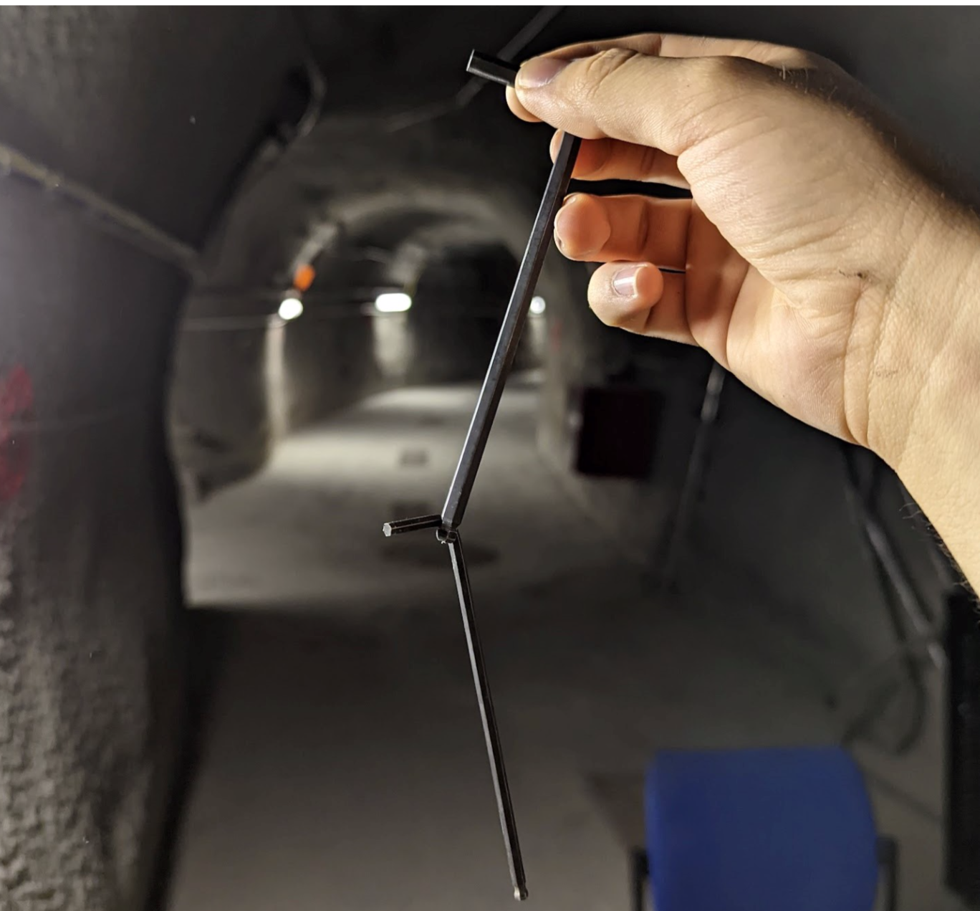
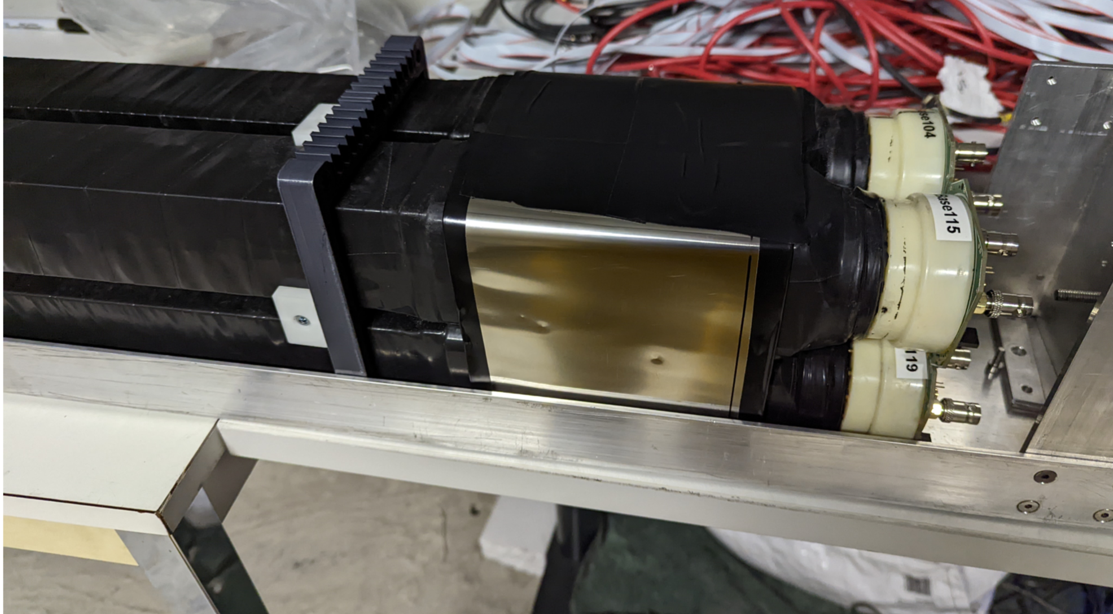
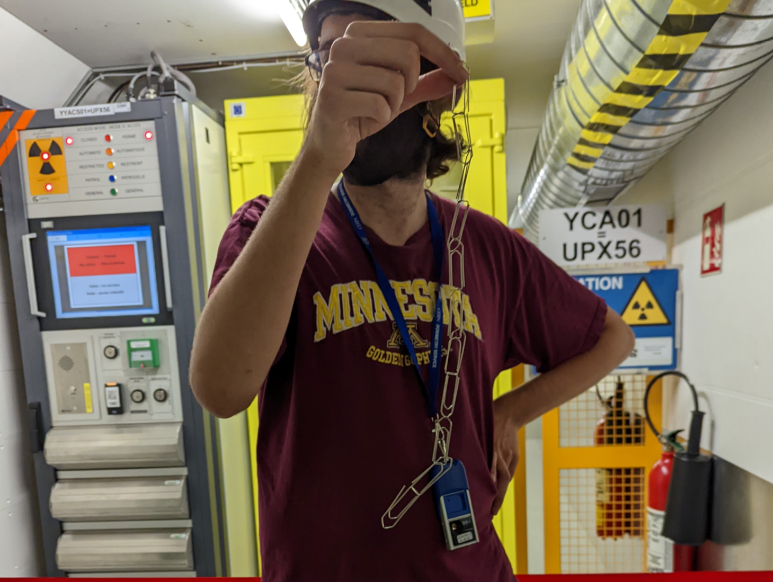
MilliQan detector design – magnetic shielding
Residual magnetic field from the CMS solenoid is about 20 G
Degrades PMT’s QE
Shield with mu-metal
CMS experimental site (P5)
milliQan
Mu-metal shield around PMTs
11/26

Slide 12
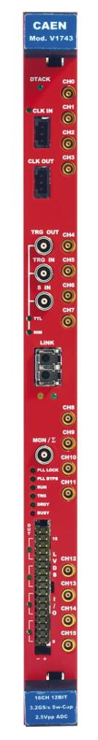
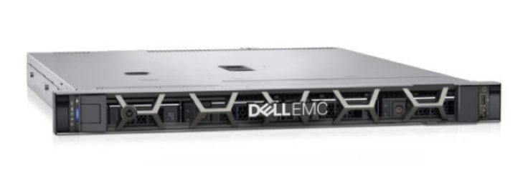
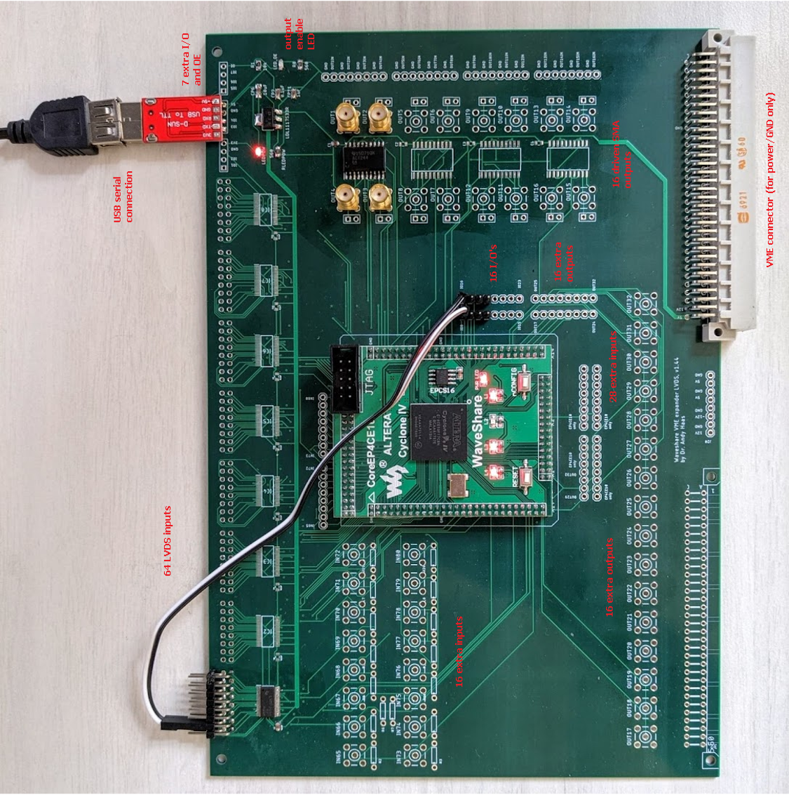
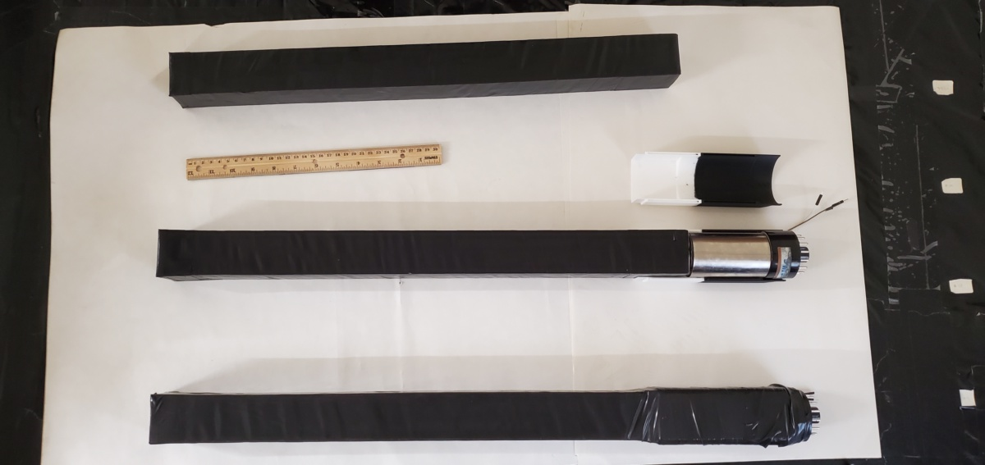
MilliQan detector design -- DAQ
DAQ Computer
Amplified PMT data input to CAEN digitizer
Digitizers record waveforms and send configurable triggers to trigger board
FPGA implements trigger menu including calibration and control triggers
CMS experimental site (P5)
Digitized Pulses
Trigger Information
Trigger Board
Global Trigger
milliQan
Channel Triggers
PMT Pulse
Scintillator Bar
CAEN Digitizer
12/26

Slide 13
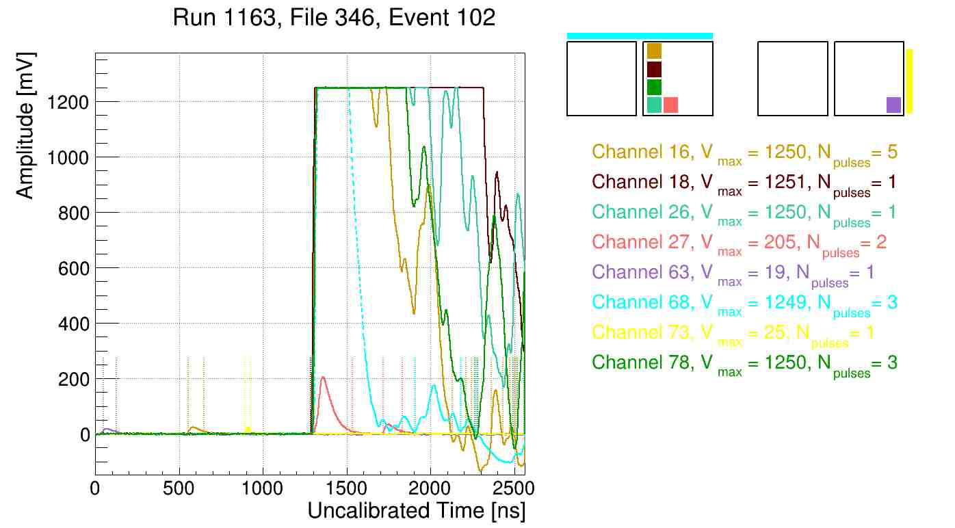
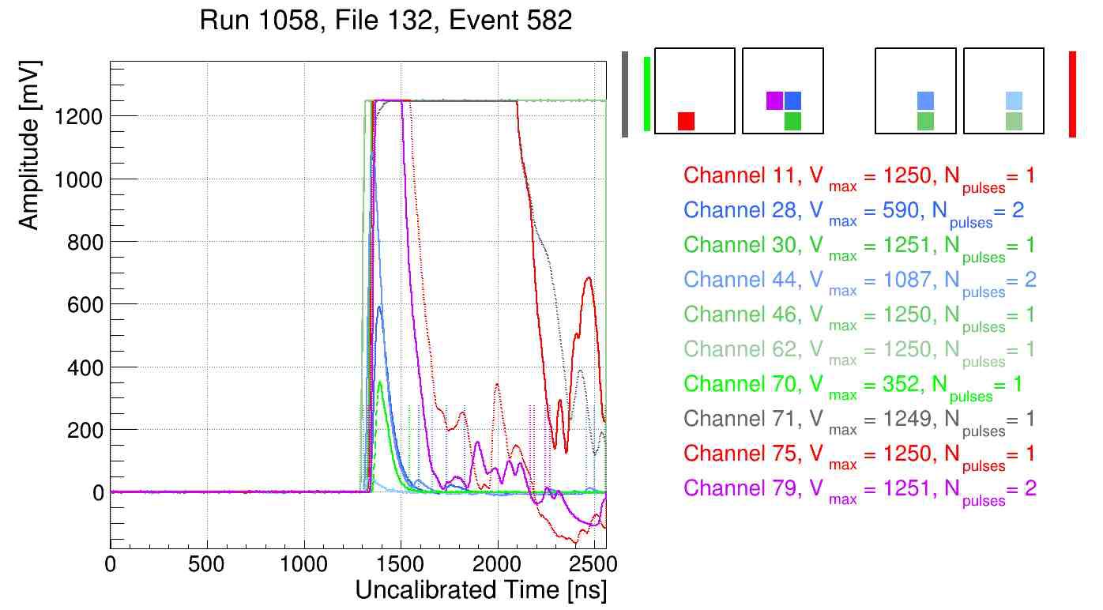
MilliQan detector design – reconstruction
Waveforms processed with pedestal corrections and noise suppression
Pulses identified and recorded
13/26

Slide 14
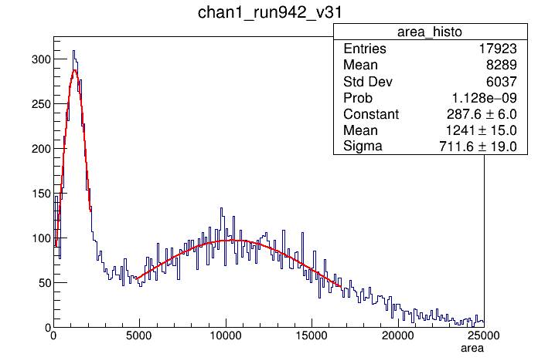
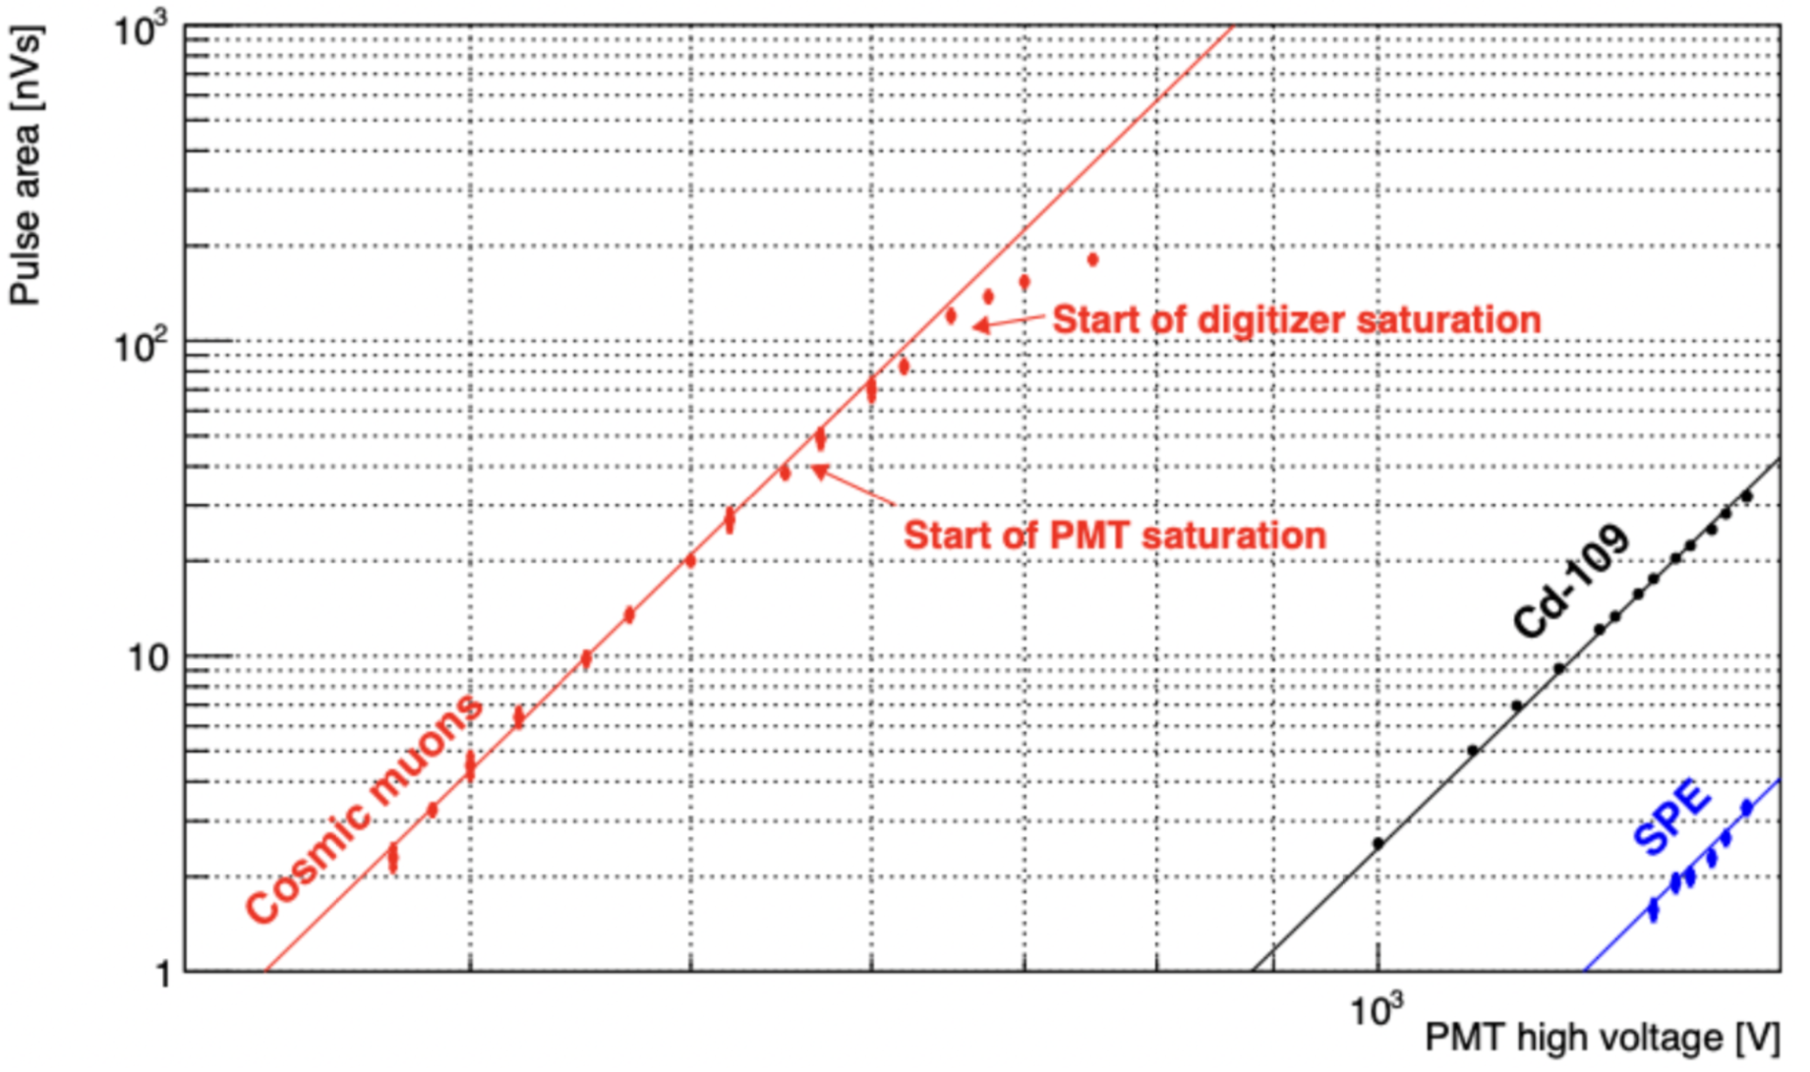
MilliQan detector design – calibration
Pulse area ∝ nPE ∝ E_{dep}
Calibrate nPE/keV with 3 & 23 keV x rays from ¹⁰⁹Cd source; can also use cosmic-ray muons
CMS experimental site (P5)
SPE peak
Pulse area (nVs)
23 keV peak from ¹⁰⁹Cd
Pulse area (pVs)
14/26

Slide 15
MilliQan detector design – calibration
Pulse time calibrated with beam and cosmic-ray muons
Beam muon rate is low, matched MC prediction
in Run2 demonstrator
CMS experimental site (P5)
MilliQan Run2 demonstrator
15/26

Slide 16
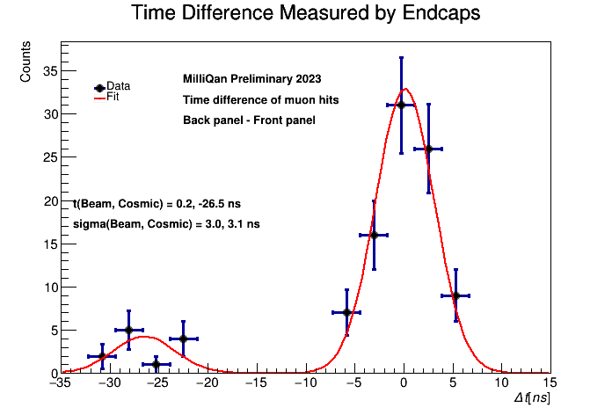
MilliQan detector design – calibration
Pulse time calibrated with beam and cosmic-ray muons
Beam muon rate is low, matches MC prediction
CMS experimental site (P5)
16/26

Slide 17
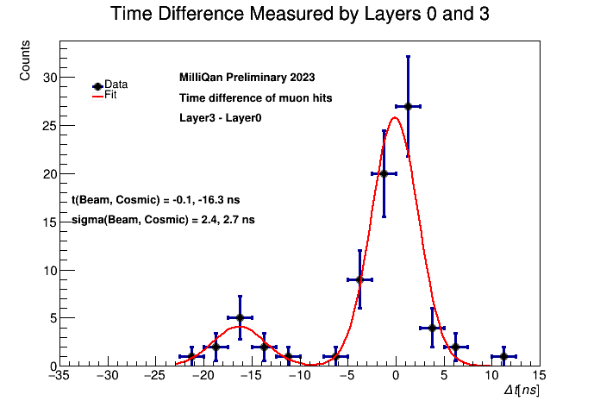
MilliQan detector design – calibration
Pulse time calibrated with beam and cosmic-ray muons
Beam muon rate is low, matches MC prediction
CMS experimental site (P5)
17/26

Slide 18
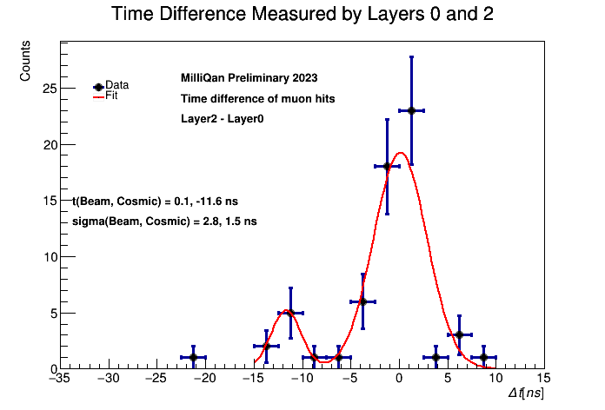
MilliQan detector design – calibration
Pulse time calibrated with beam and cosmic-ray muons
Beam muon rate is low, matches MC prediction
CMS experimental site (P5)
18/26

Slide 19
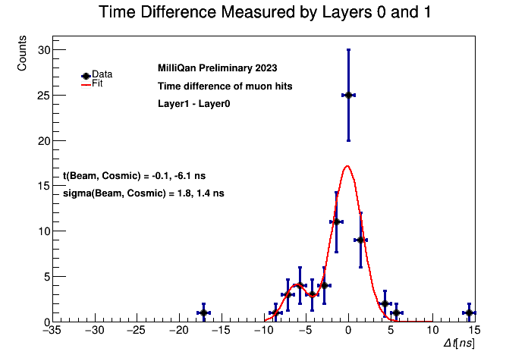
MilliQan detector design – calibration
Pulse time calibrated with beam and cosmic-ray muons
Beam muon rate is low, matches MC prediction
CMS experimental site (P5)
19/26

Slide 20
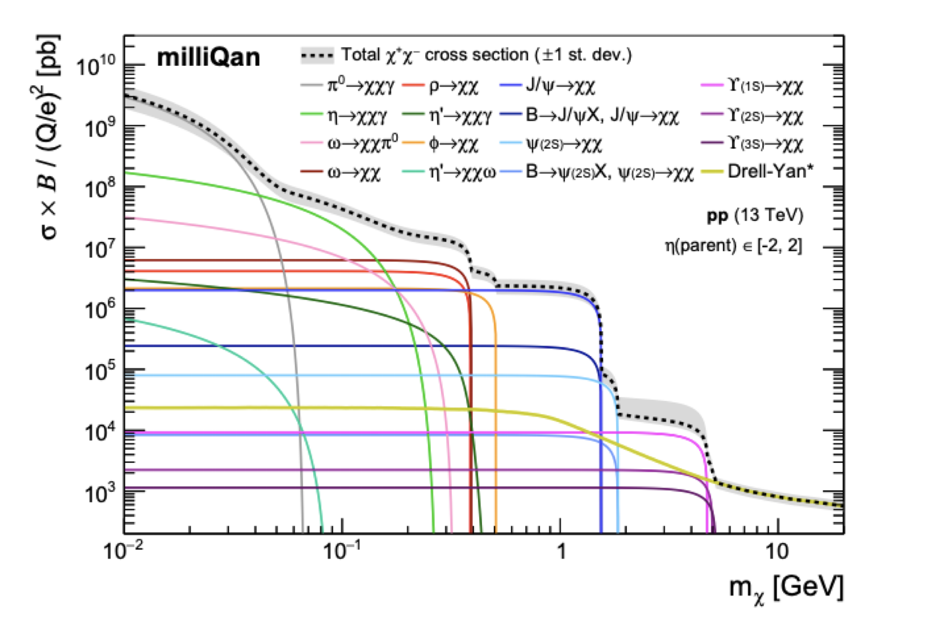
Production of milli-charged particles at the LHC
Production of mCPs in LHC is the same as e⁺e⁻
  Drell-Yan and leptonic meson decays
Simulate mCPs in pythia
Propagate through rock with GEANT
Simulate detector response with GEANT, scaled to data control samples
20/26
Notes:
$$BR ∝{\left|M\right|}^{2}$$

Slide 21
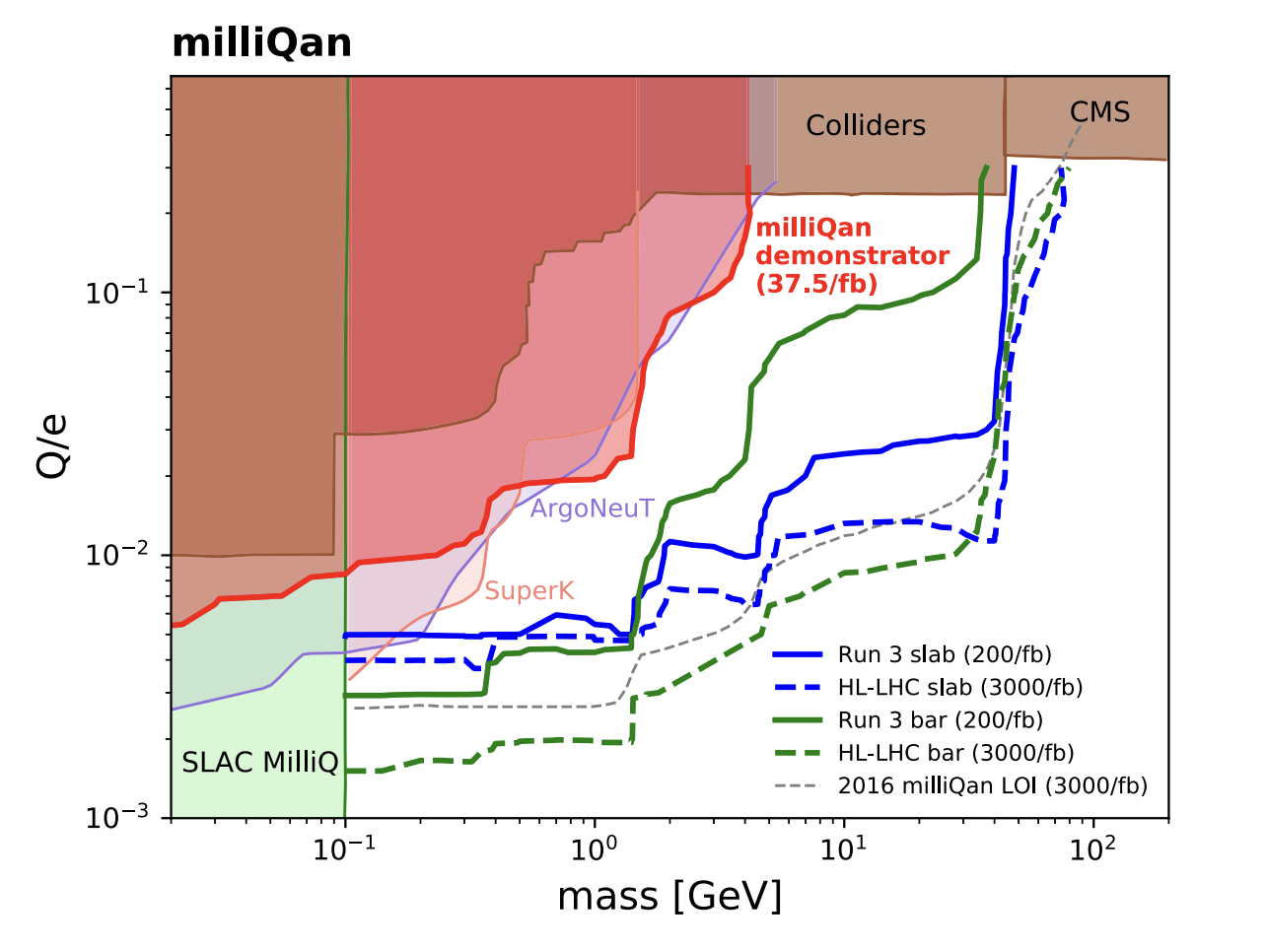
Expected Run 3 sensitivity
Large increase in sensitivity from Run 2 demonstrator
Sensitivity steps in mass due to production modes
Run 3 Bar Detector
MilliQan demonstrator
Run 3 Slab Detector
21/26
Notes:
$$BR ∝{\left|M\right|}^{2}$$

Slide 22
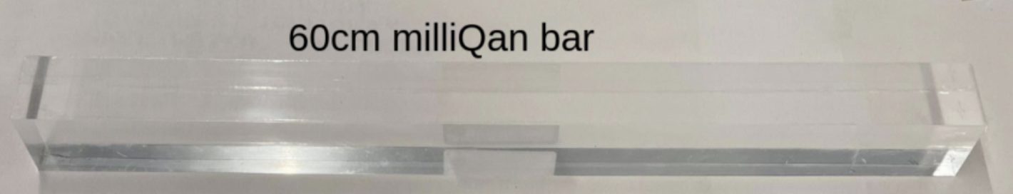
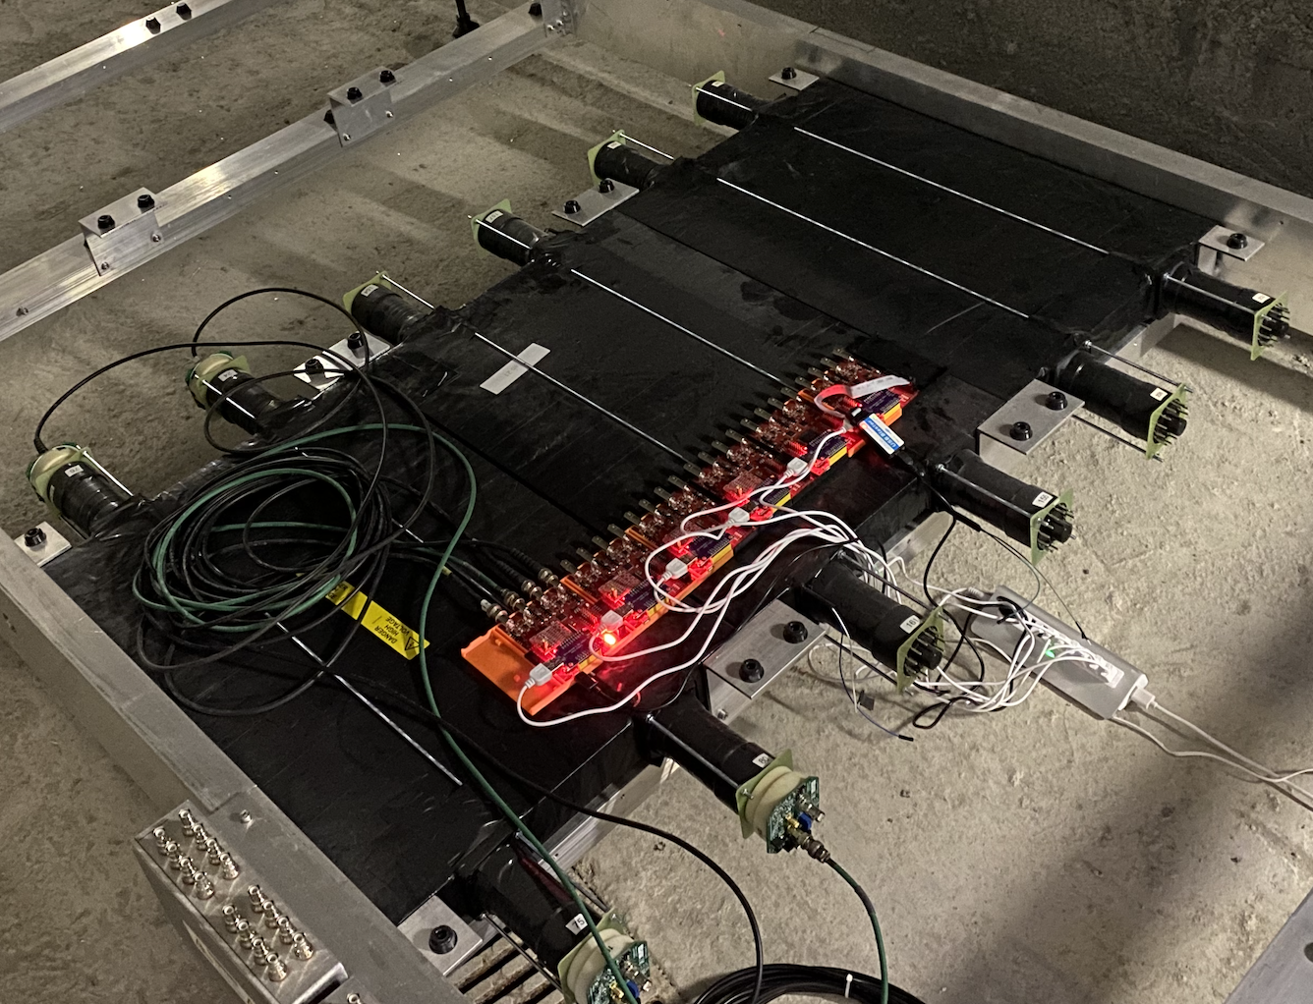
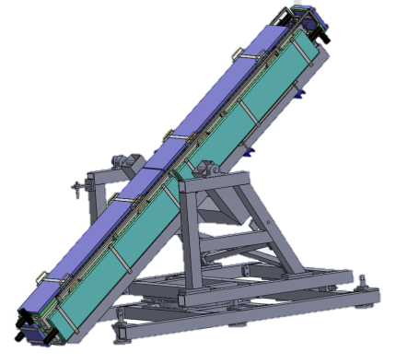
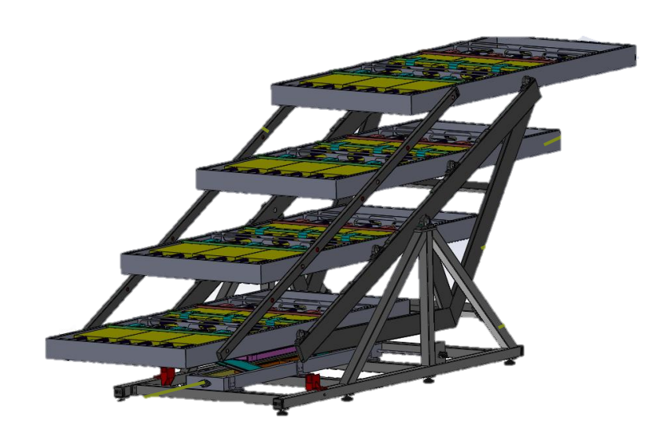
MilliQan detector design – bars vs slabs = thick vs wide
Bar detector targets sensitivity to lowest charge
Slab detector extends sensitivity to higher mass
Run 3 Bar Detector
MilliQan demonstrator
Run 3 Slab Detector
milliQan
22/26

Slide 23
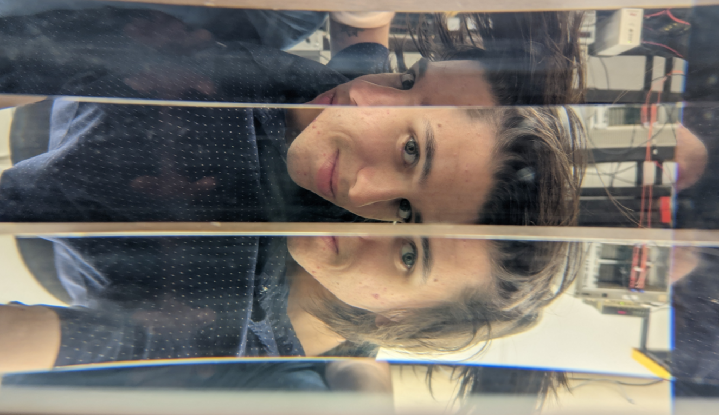
MilliQan detector design – bars vs slabs = thick vs wide
Bar detector targets sensitivity to lowest charge
Slab detector extends sensitivity to higher mass -- 4 PMTs summed into 2 outputs
nPE/keV similar to bars.
Slab detector construction underway.
milliQan
23/26

Slide 24
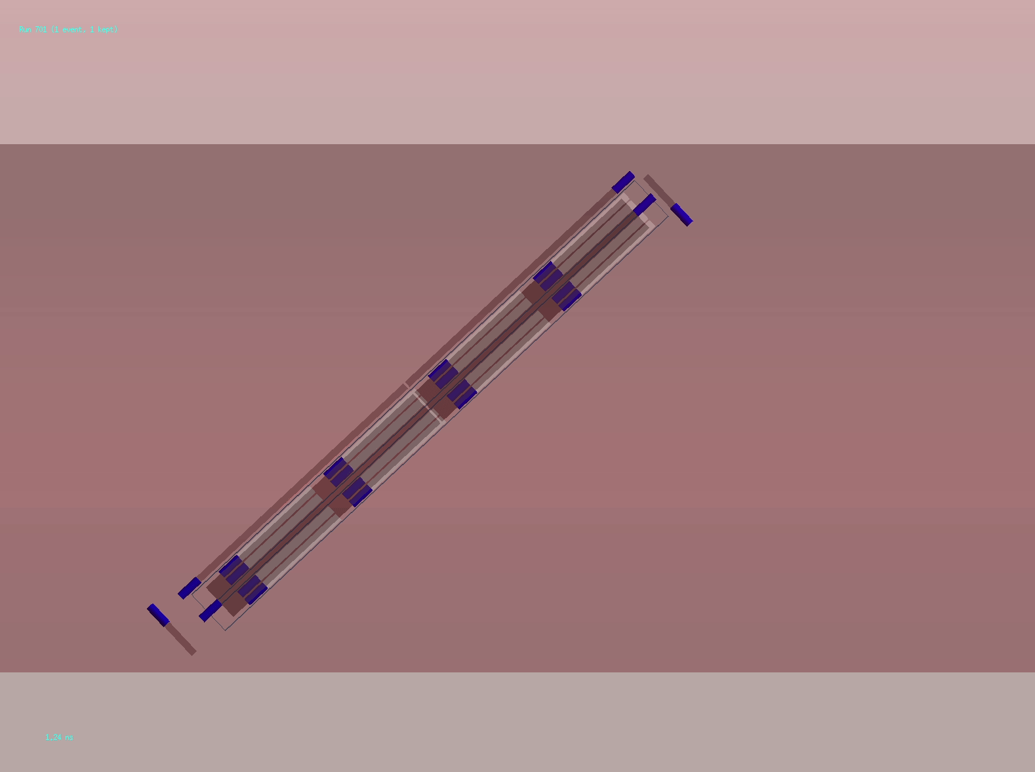
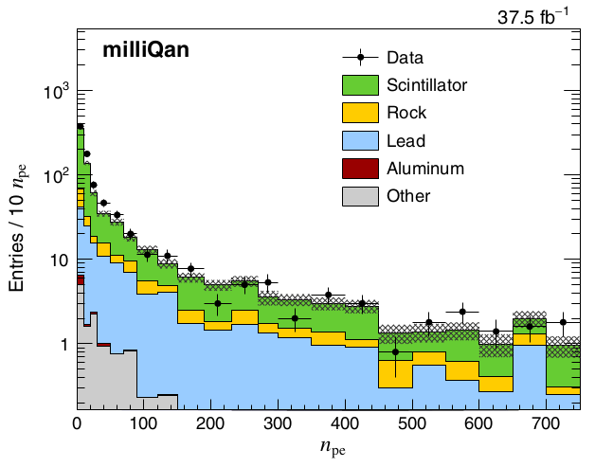
Backgrounds
Signal gives 4 low-nPE hits that are in-line and in-time, with no other channels hit
Background is from overlapping hits, e.g., from cosmic showers and dark noise
Simulated cosmic ray muon
Measured distributions in Run2 demonstrator well-matched to simulation.
Muon
mCP
Gamma
e⁻ e⁺
Visible photon
milliQan
24/26

Slide 25
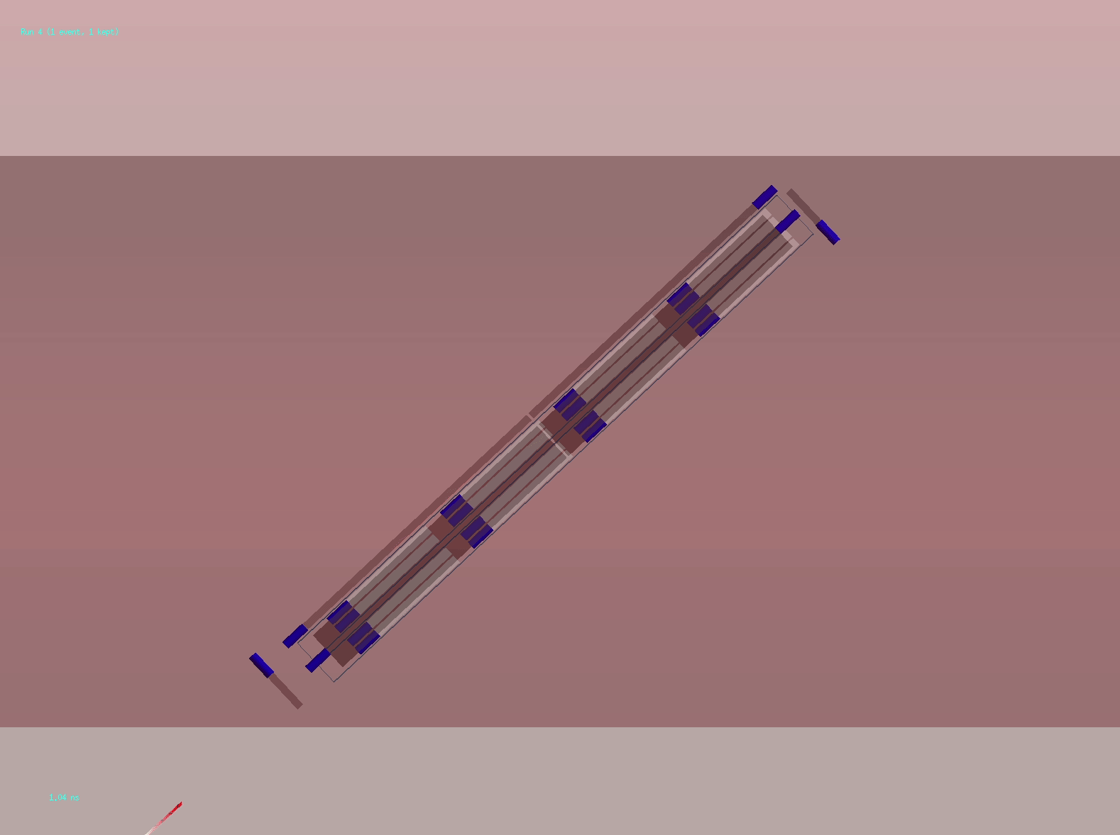

Backgrounds
Signal gives 4 low-nPE hits that are in-line and in-time, with no other channels hit
Background is from overlapping hits, e.g., from cosmic showers and dark noise
Simulated muon from IP
Simulated mCP
Muon
mCP
Gamma
e⁻ e⁺
Visible photon
milliQan
25/26

Slide 26

Summary
The MilliQan experiment targets fractionally
charged particles in window from 0.1 – 45 GeV
Bar detector has been taking data since June
Calibrated with sources, cosmic ray muons,
& muons from the IP
Slab detector construction ongoing
Will calibrate with cosmic rays
First beam next year
milliQan
Funded by
26/26

Slide 27
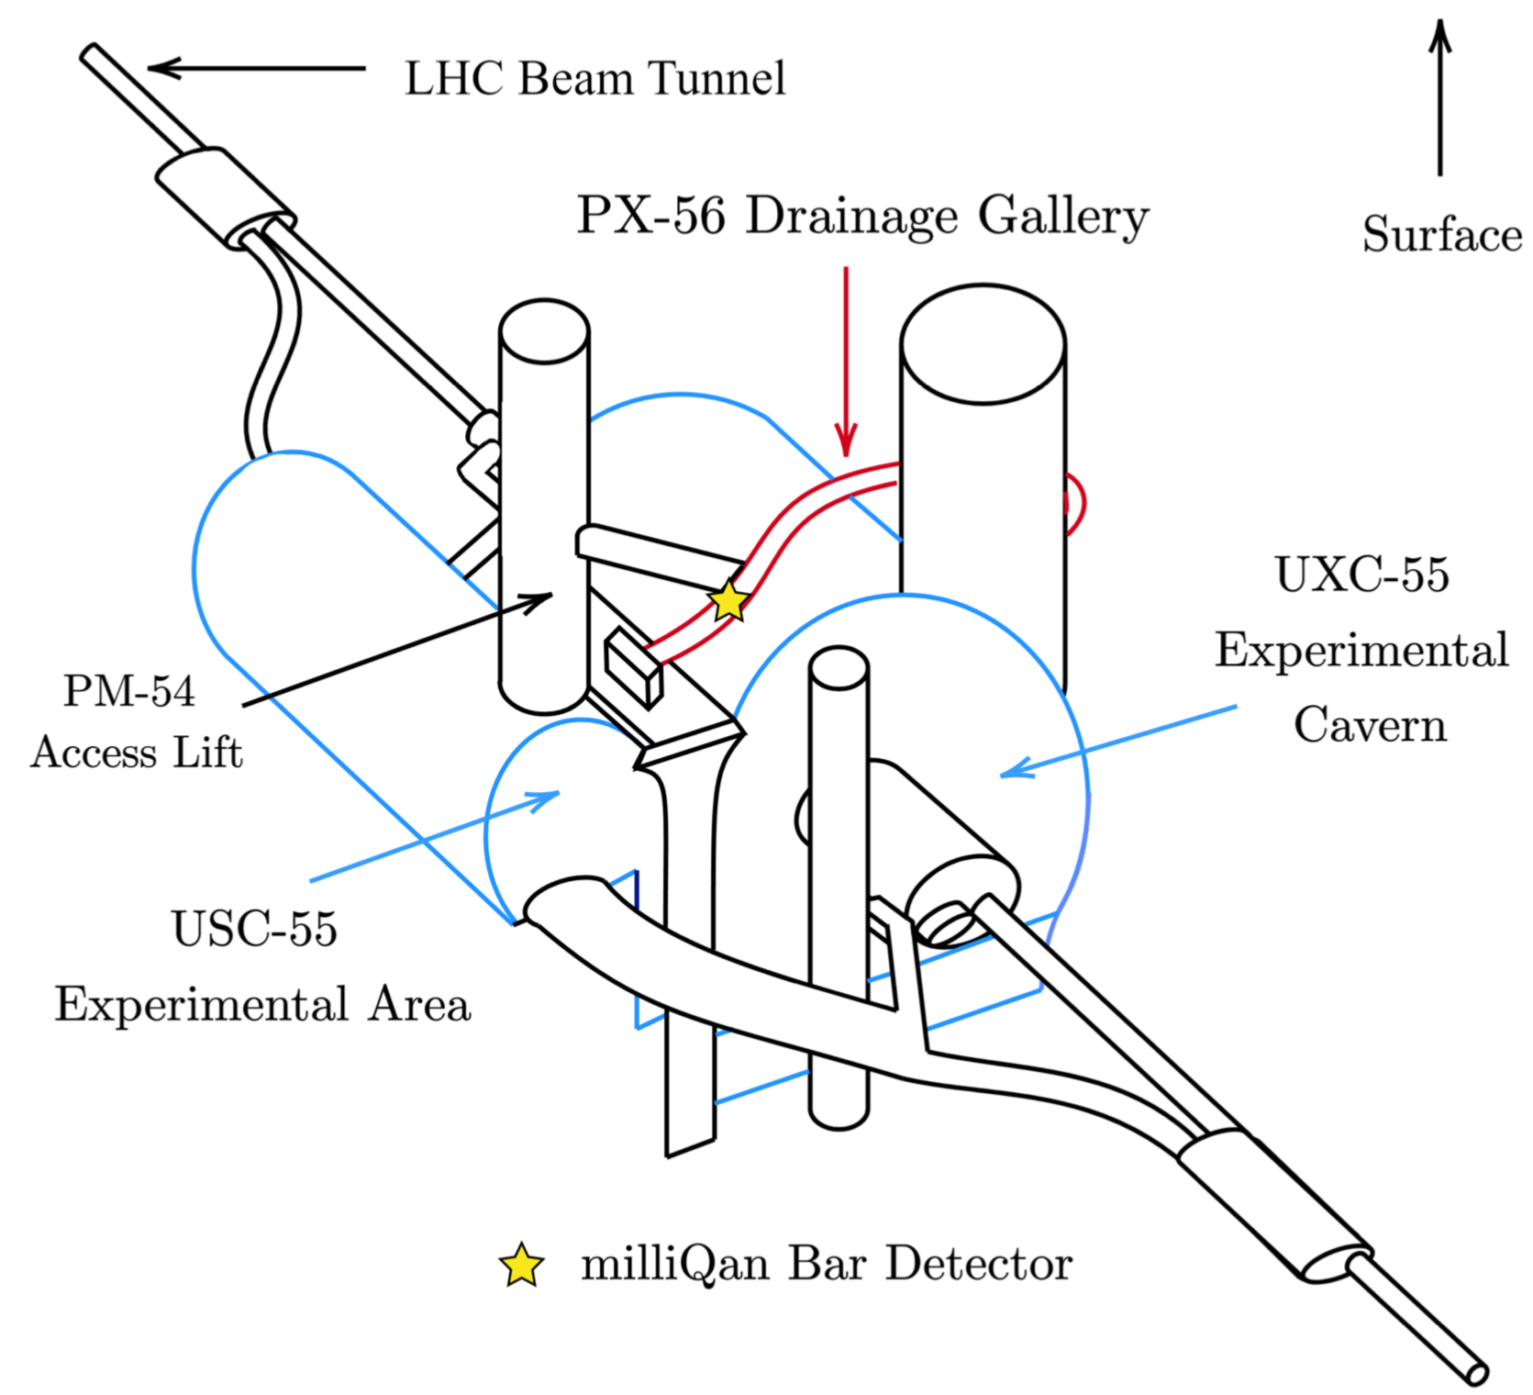
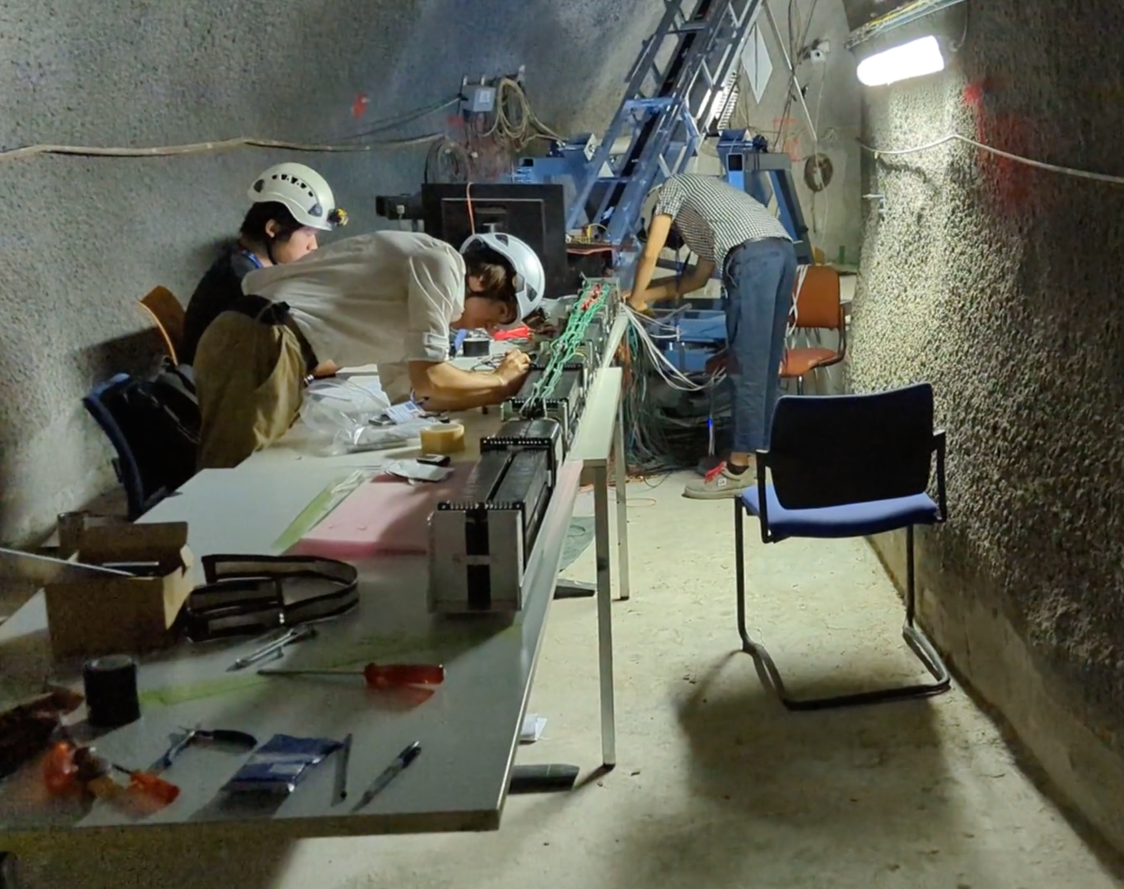
Virtual tour
A video providing a virtual tour is linked in indico.
CMS experimental site (P5)
path
27/26

